Slide 1
Hospital Admissions
Dylan Kemp (V00947368)
Kate Ueda (V00887735)
Bryce Eppler (V00938776)

Slide 2
Summary
The hospital admissions dataset contains information about patients admitted to Hero DMC Heart Institute, Unit of Dayanand Medical College and Hospital in Ludhiana, Punjab, India over a period of two years.
The cardiology unit had 14,845 admissions corresponding to 12,238 patients, of which 1921 had multiple admissions.
The dataset includes patient demographics, patient history, medical conditions, and outcomes indicating whether the patient was discharged or expired in the hospital.

Slide 3
Considered Questions
Is there a relationship between certain patient demographics (age, gender, etc.) and duration of hospital stay?
What are the most influential predictors for patient outcome at the time of admission?

Slide 4
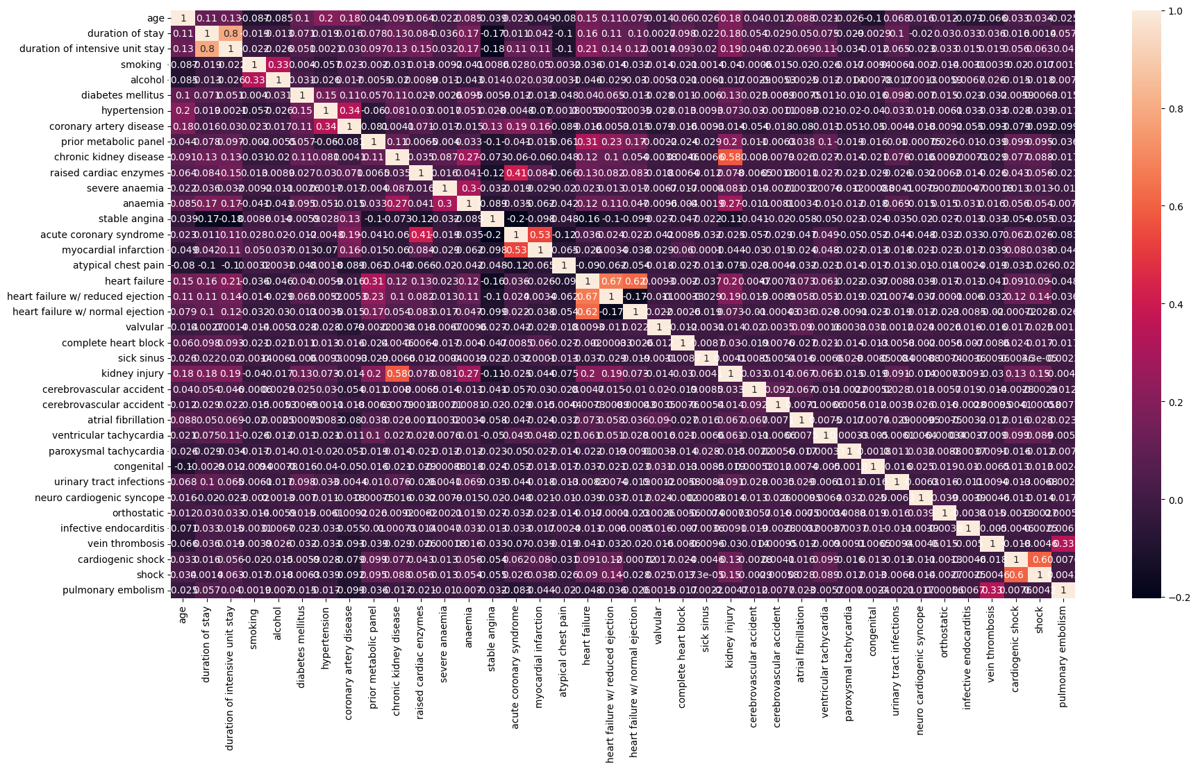
Data Collection - Correlation Heatmap

Slide 5
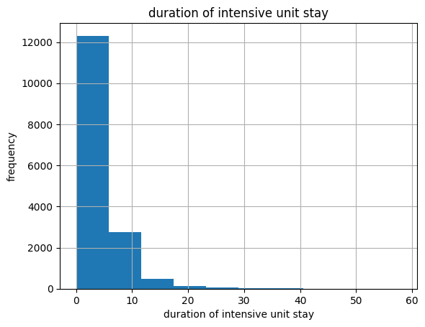
Data Collection - Duration of Hospital Stay

Slide 6
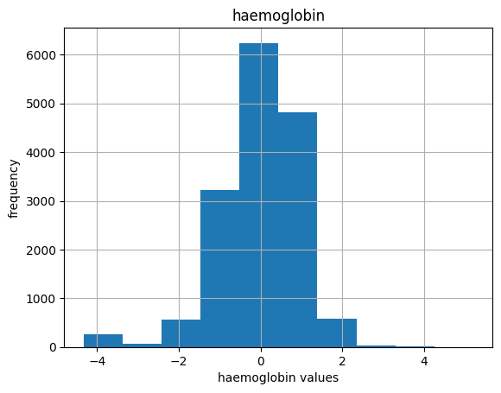
Data Collection - Haemoglobin Values

Slide 7
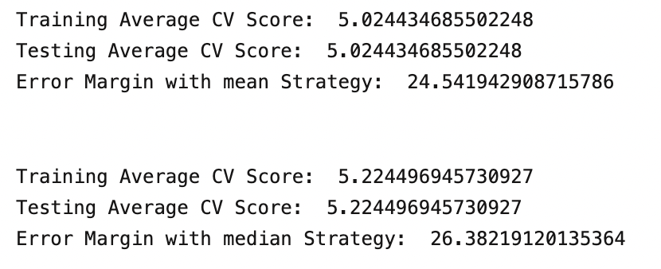
Evaluating Performance of Dummy Regressor Model

Slide 8
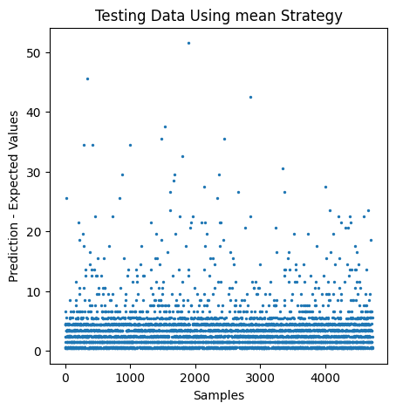
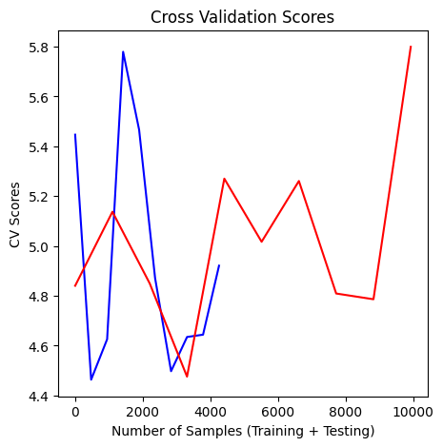
Dummy Regressor - Testing Data Using Mean Strategy

Slide 9
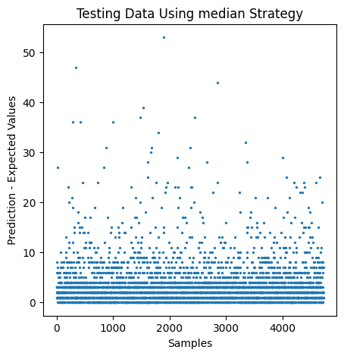
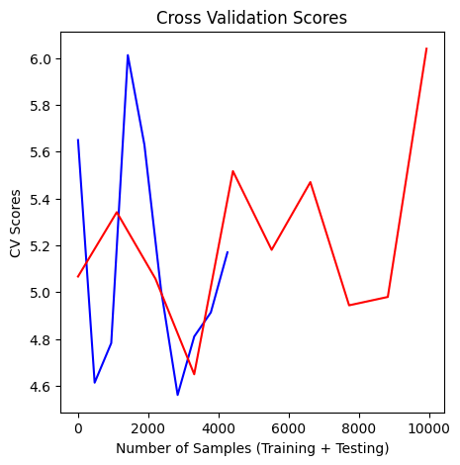
Dummy Regressor - Testing Data Using Median Strategy

Slide 10
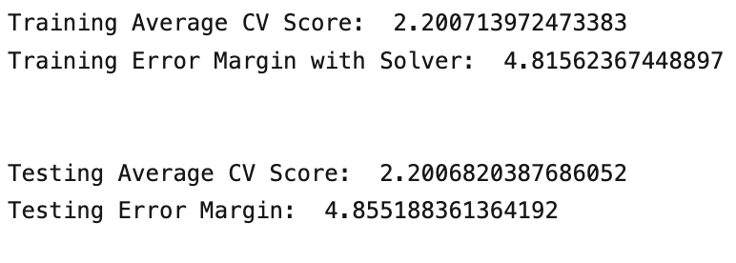
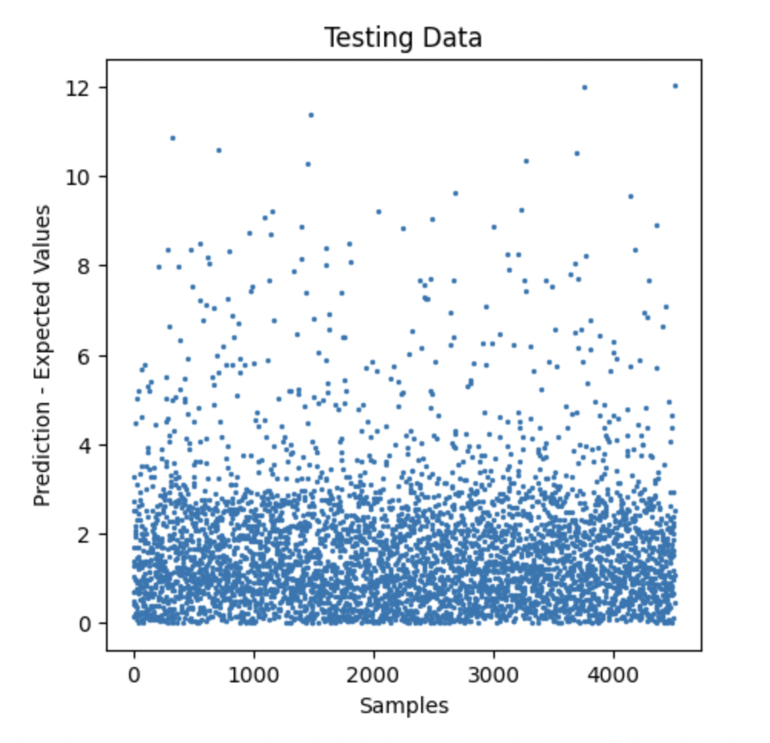
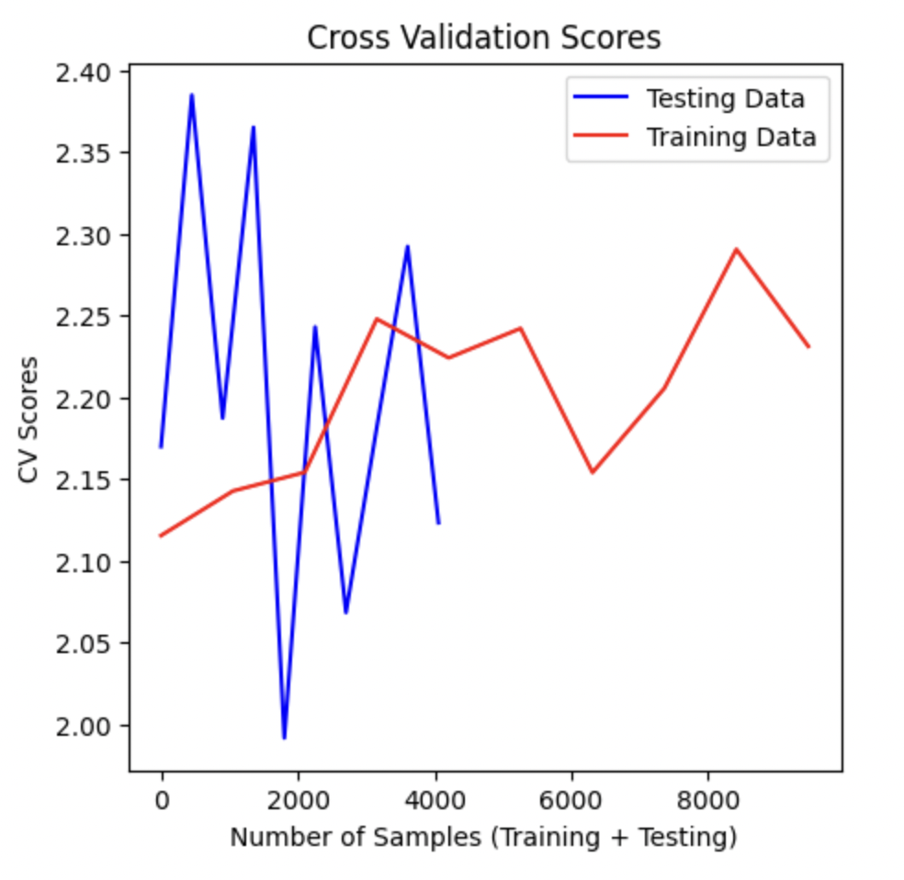
Linear Regression to Predict Duration of Hospital Stay

Slide 11
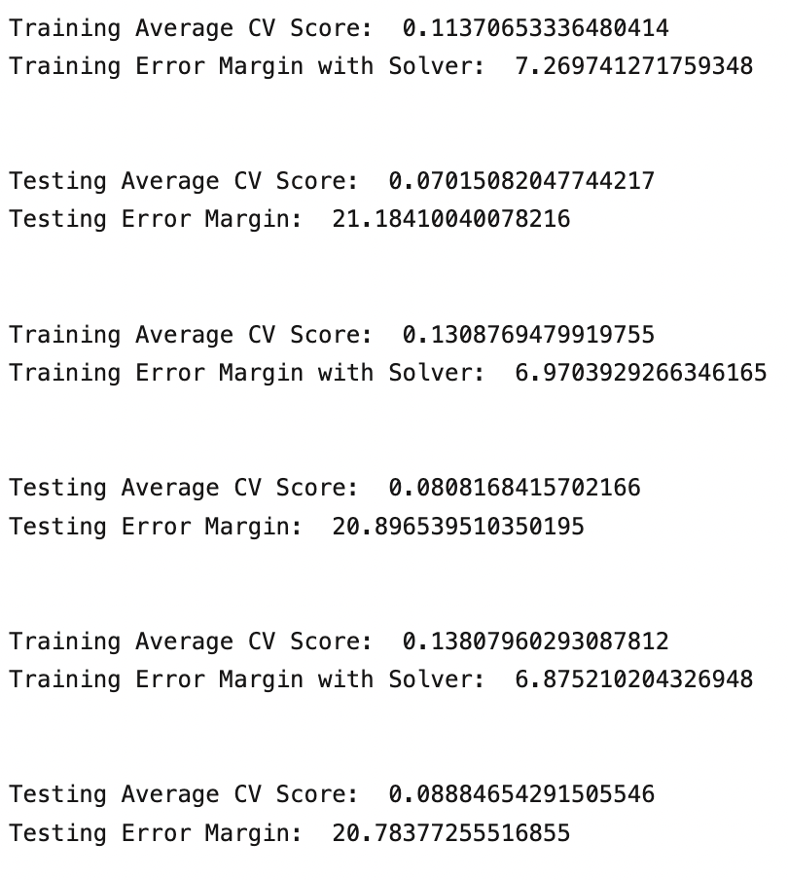
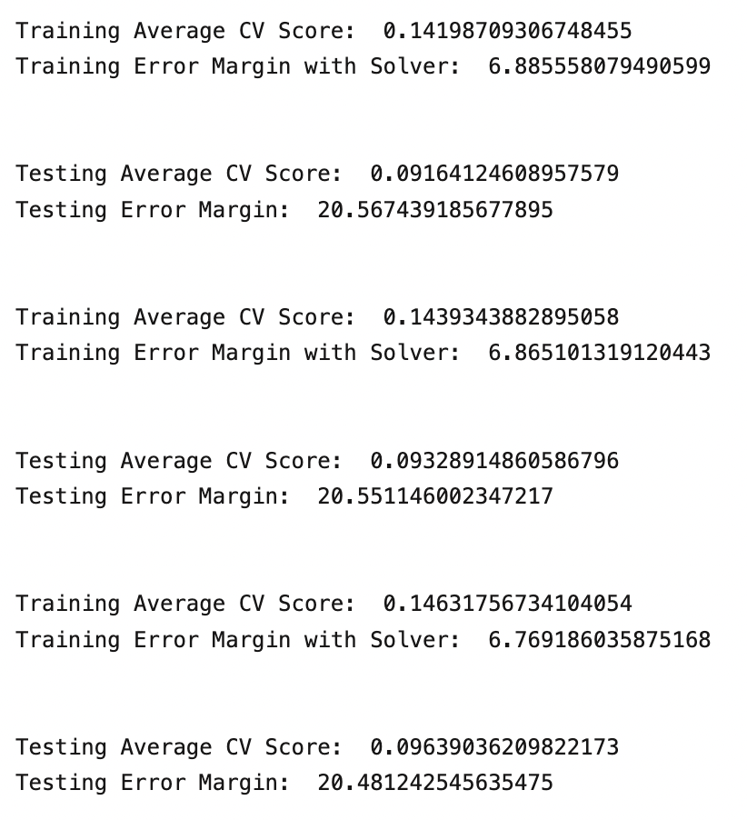
Random Forest Regression - Model One

Slide 12
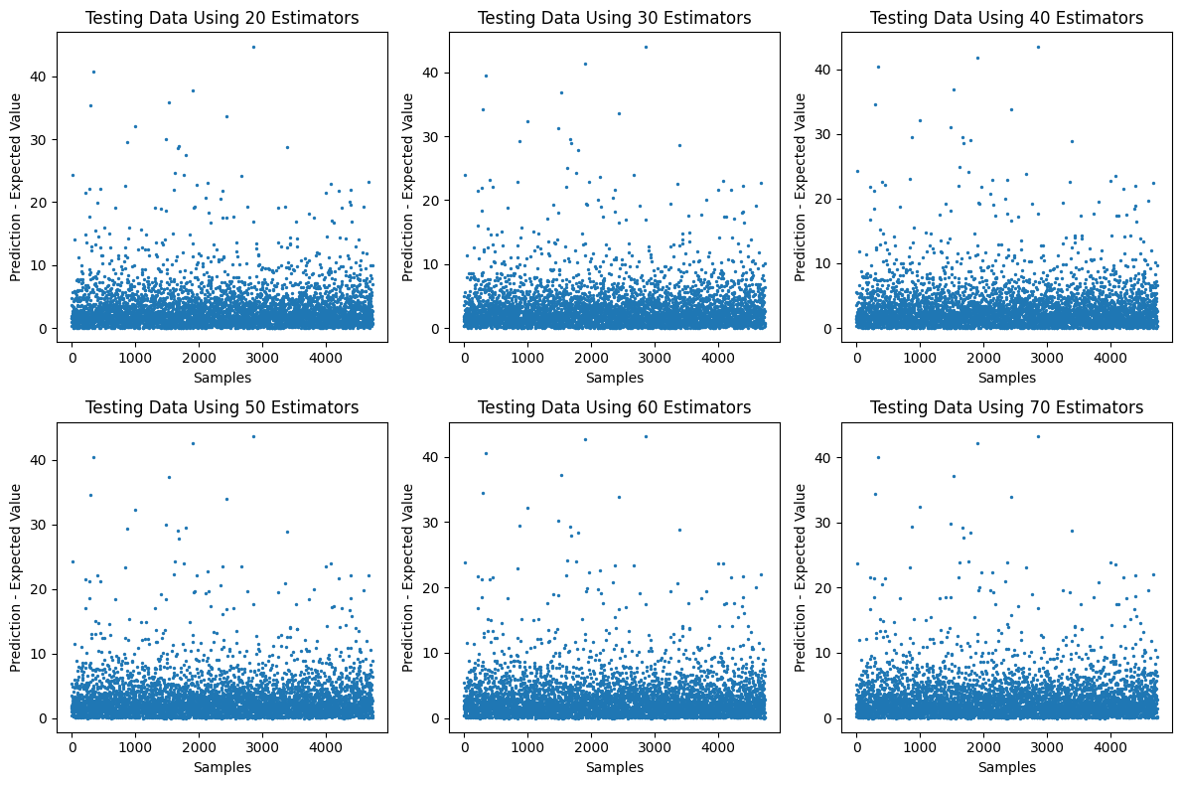
Random Forest Regression - Model One

Slide 13
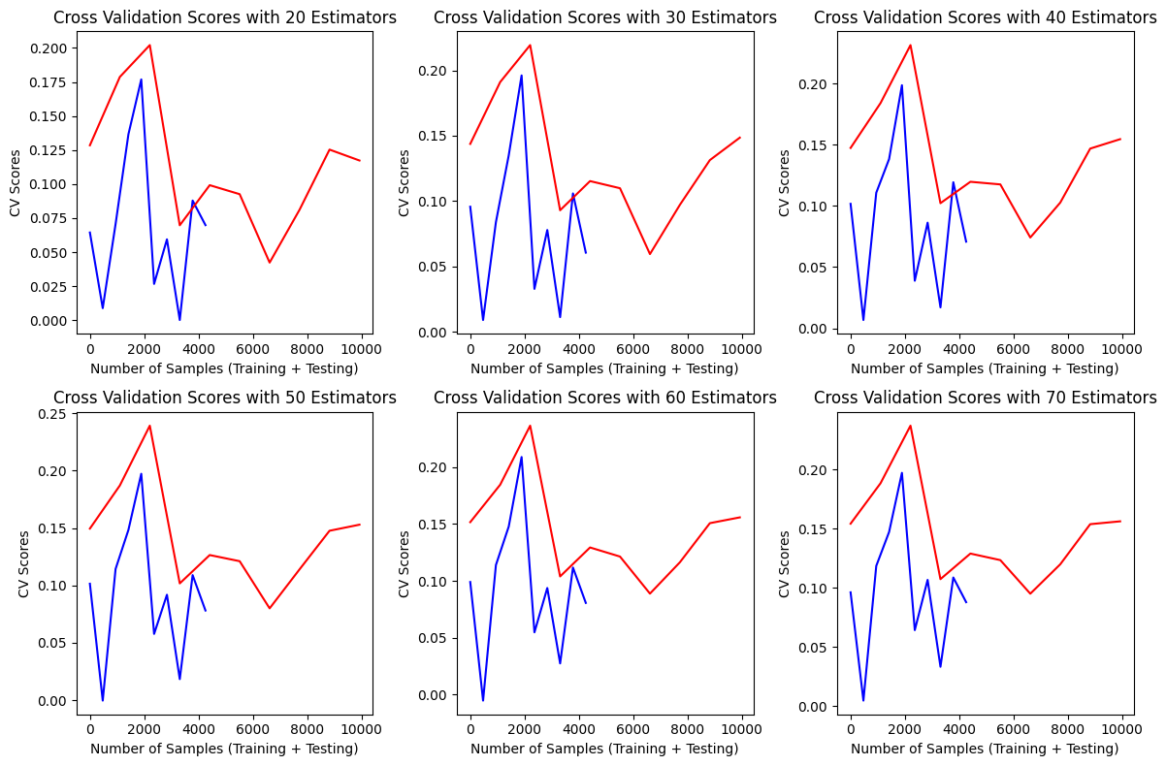
Cross Validation Scores - Model One

Slide 14
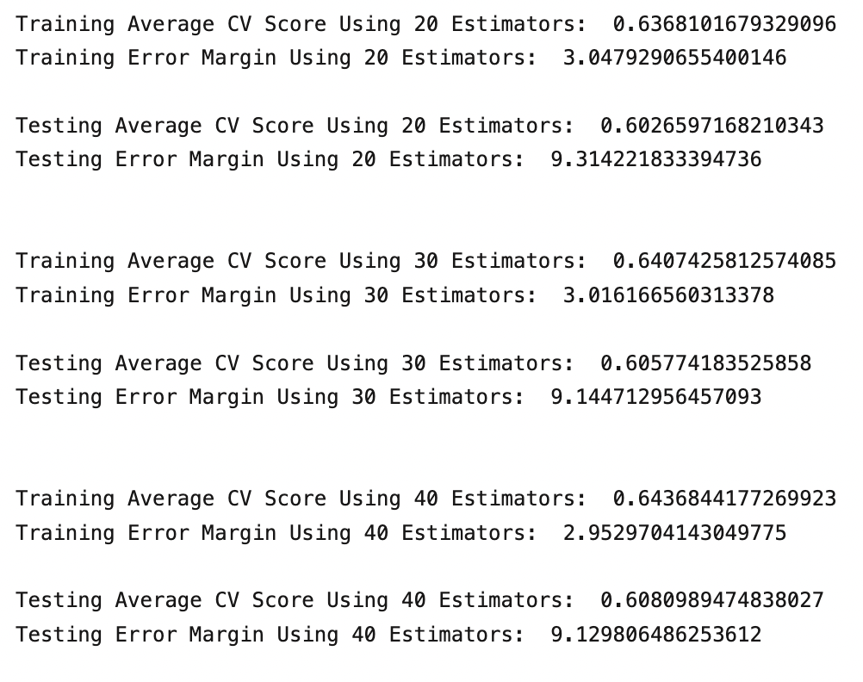
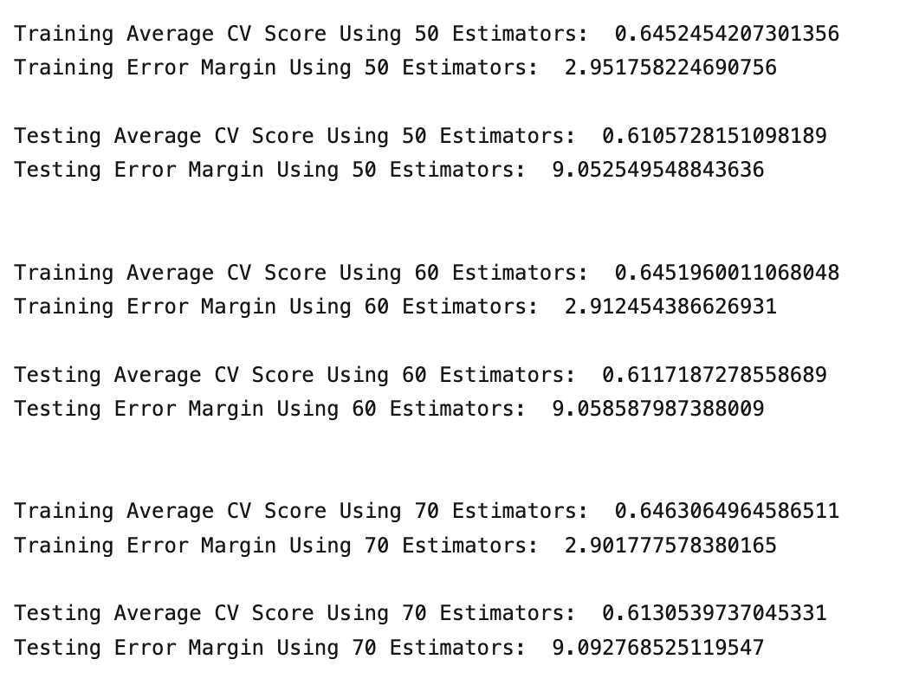
Improving Random Forest Regression
Expanding Features For Better Prediction

Slide 15
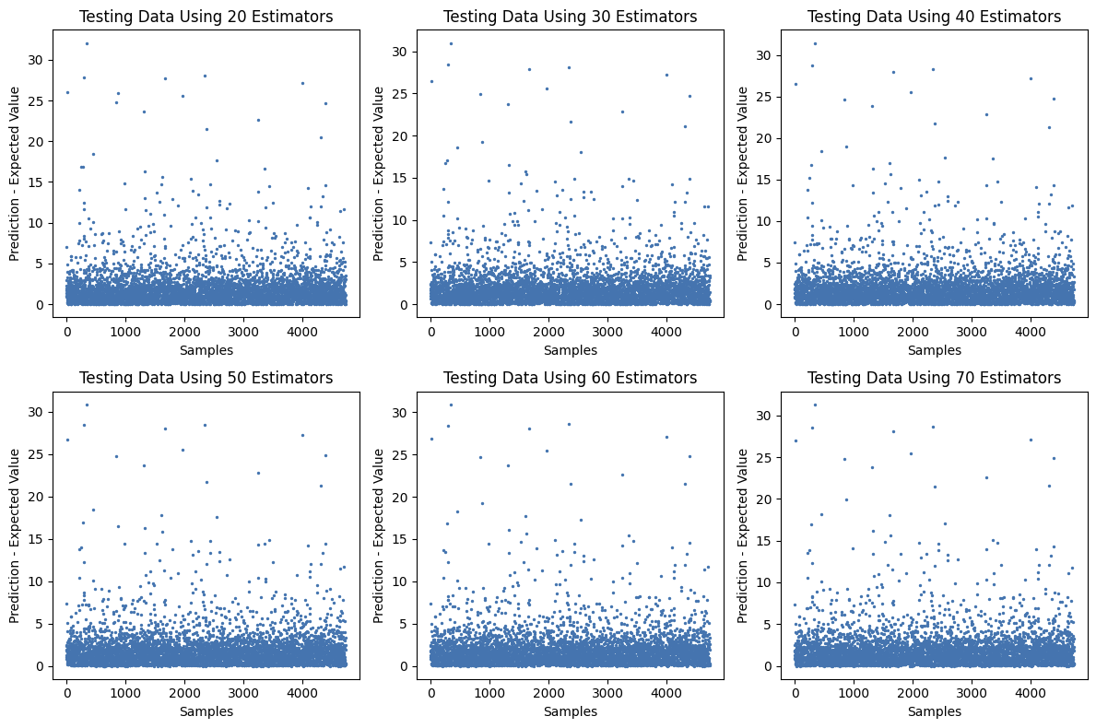
Improving Random Forest Regression

Slide 16
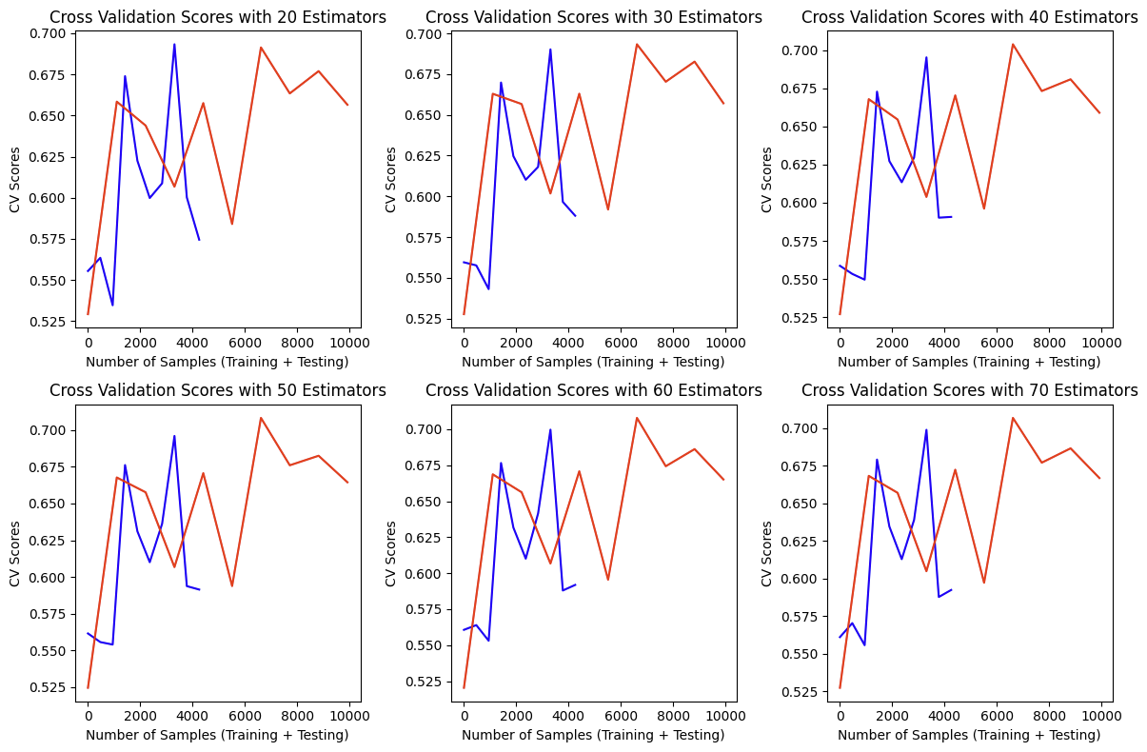
Improving Random Forest Regression - Cross Validation Scores

Slide 17
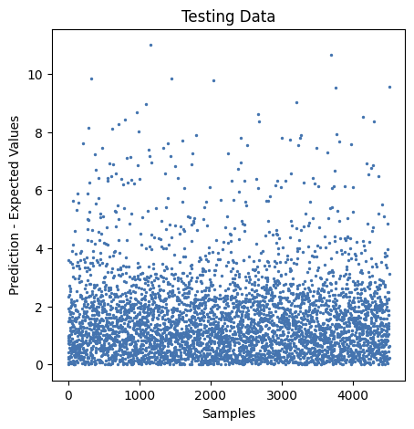
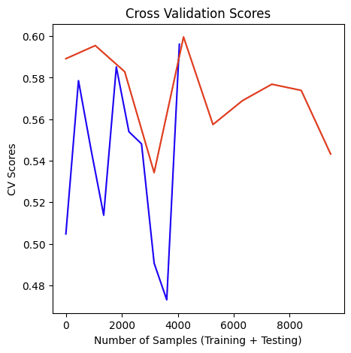
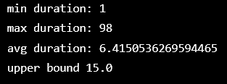
Reduce Error Margin By Bounding Label

Slide 18
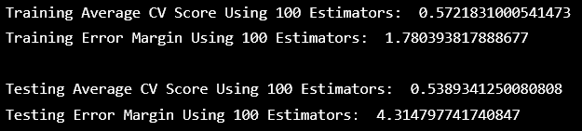
Reduce Error Margin By Bounding Label

Slide 19
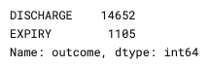
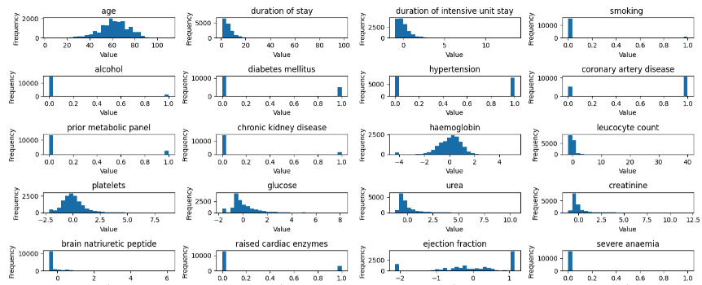
Logistic Regression to Predict Admission Outcome

Slide 20
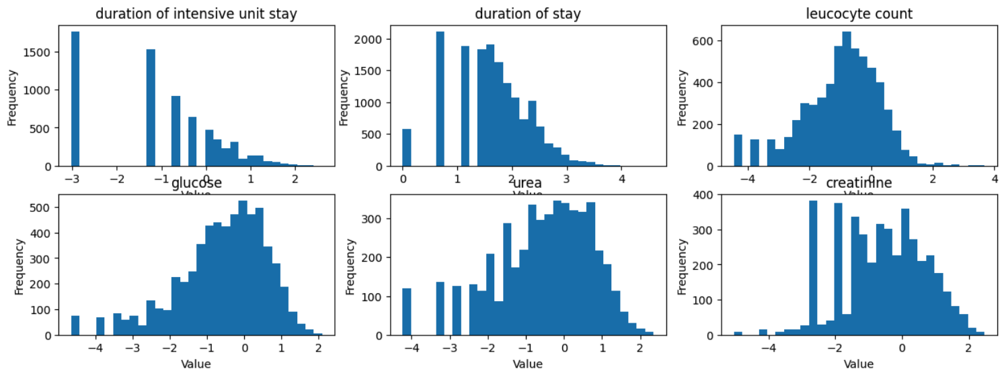
Data Processing
duration of stay / duration of intensive unit stay

Slide 21
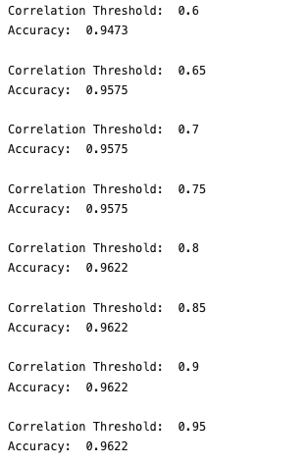
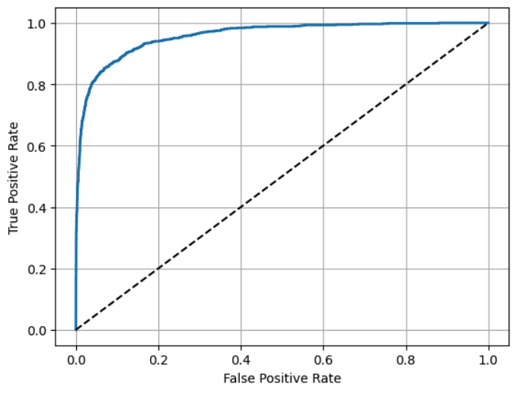
Performance

Slide 22
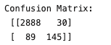
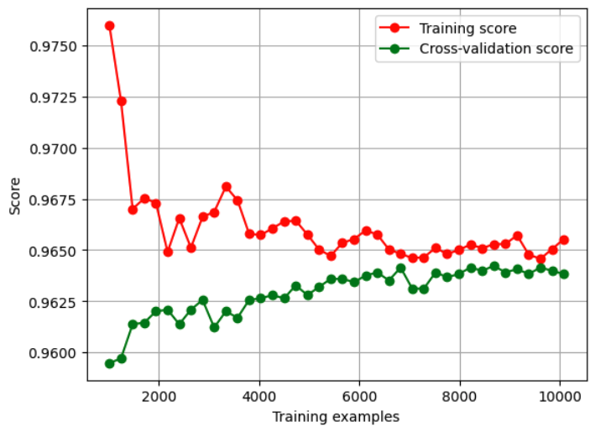
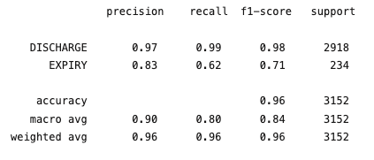
Evaluation
5 fold cross validation

Slide 23
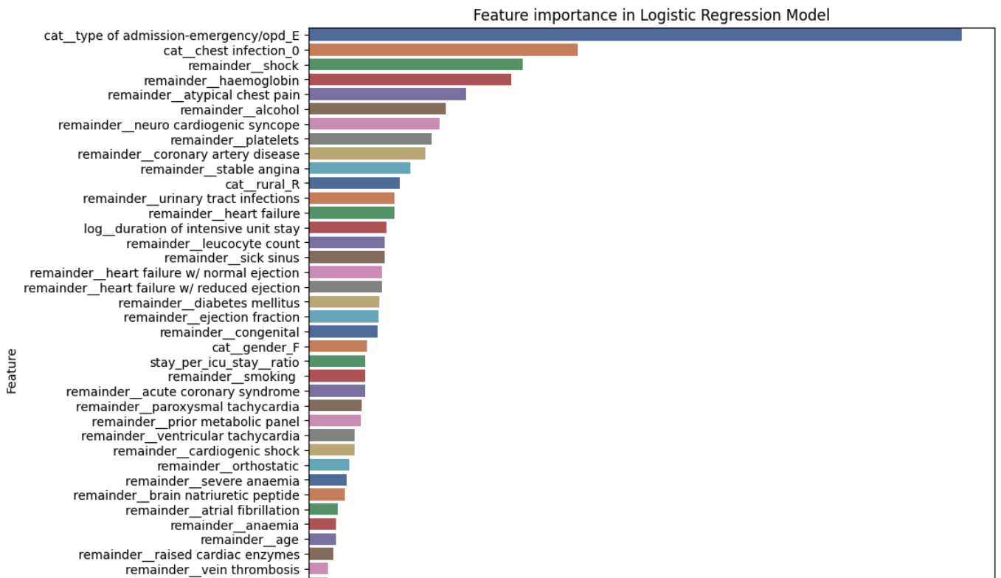
Model Coefficients

Slide 24
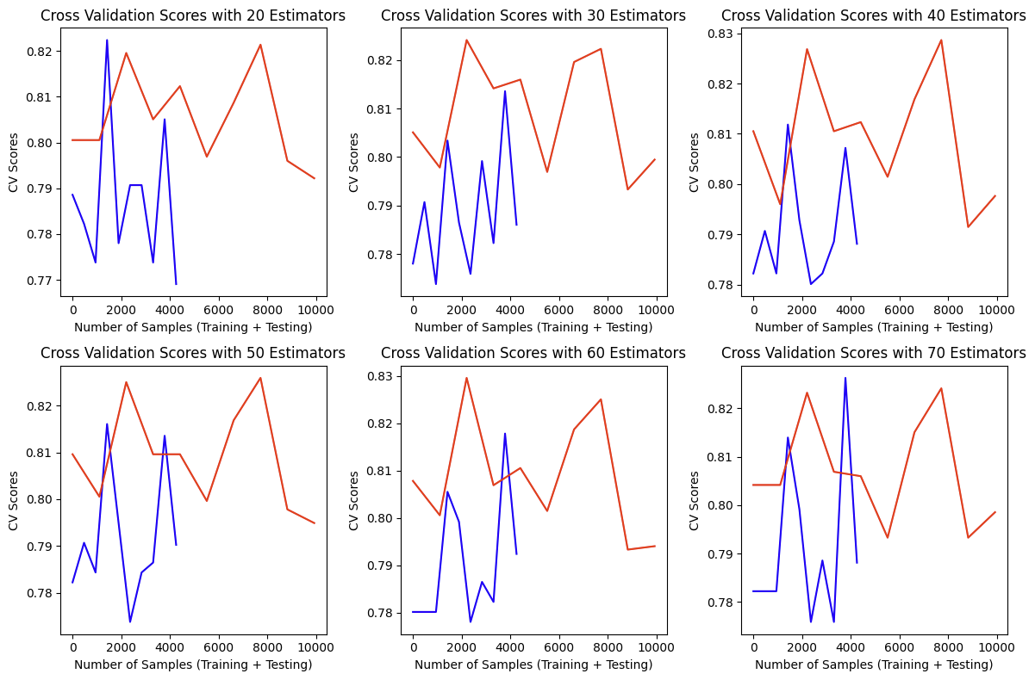
Random Forest Classification to Predict Heart Attack

Slide 25
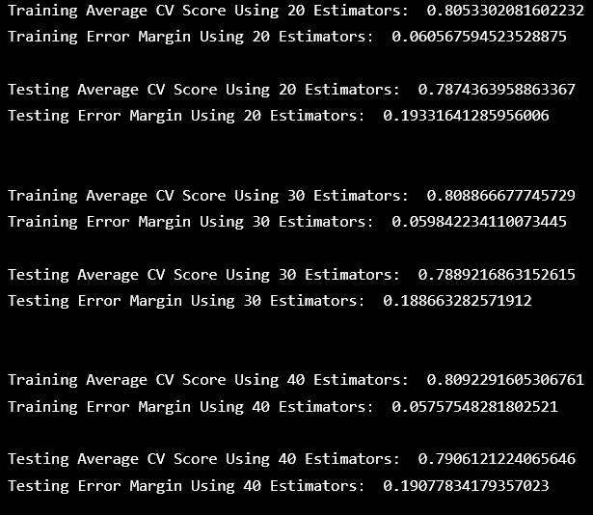
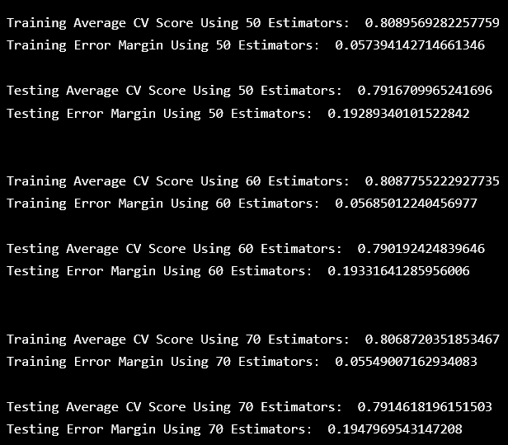
Random Forest Classification - Results

Slide 26
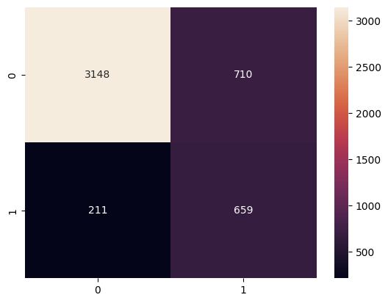
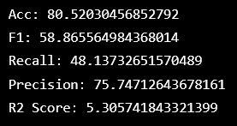
Metrics - Heart Attack

Slide 27
References
Bollepalli, S.C.; Sahani, A.K.; Aslam, N.; Mohan, B.; Kulkarni, K.; Goyal, A.; Singh, B.; Singh, G.; Mittal, A.; Tandon, R.; Chhabra, S.T.; Wander, G.S.; Armoundas, A.A. An Optimized Machine Learning Model Accurately Predicts In-Hospital Outcomes at Admission to a Cardiac Unit. Diagnostics 2022, 12, 241. https://doi.org/10.3390/diagnostics12020241
[HDHI Admission data]. Hospital Admissions Data. Retrieved June 30, 2023 from https://www.kaggle.com/datasets/ashishsahani/hospital-admissions-data?select=HDHI+Admission+data.csv

